Slide 1
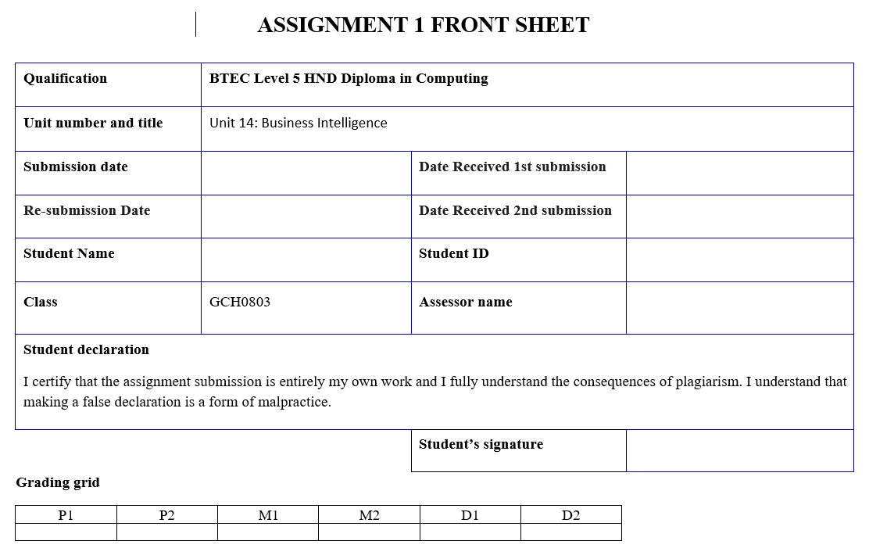
Nguyen Dinh Cuong
GBH190524
Doan Trung Tung

Slide 2
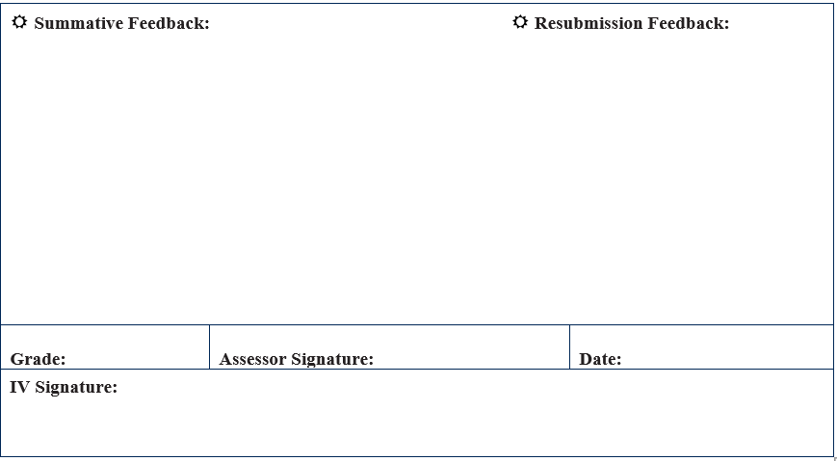

Slide 3
BUSINESS INTELLIGENCE
Class: GCH0803

Slide 4
GROUP 2
Trần Quang Huy
Nguyễn Đình Cương
Ngô Tùng Dương
Lê Minh Thiện
Nguyễn Mạnh Cường

Slide 5
Introduction
“Our auction company is built and works in Vietnam. As we all know, nowadays auction is becoming more and more popular. That's why we set up an auction company for the sake of convenience for users to exchange products or auction their products. This will make bidding easier and more convenient.”

Slide 6

Business Process
- A business process is an activity or set of activities that can accomplish a specific organizational goal.
- Business processes should have purposeful goals, be as specific as possible and have consistent outcomes.

Slide 7
Car auction!

Slide 8
Overview
Customers can register for offline auction information through the available registration form. In addition, users can register online through the application form on the company's website. Our company provides auction-related services: "Create auctions, display products, ... " . By pushing auction information on the forums to easily attract customers more easily. After completing and receiving the auction documents, the seller can auction their products. . Buyers only need to complete all the registration steps to be able to participate in the auction.

Slide 9
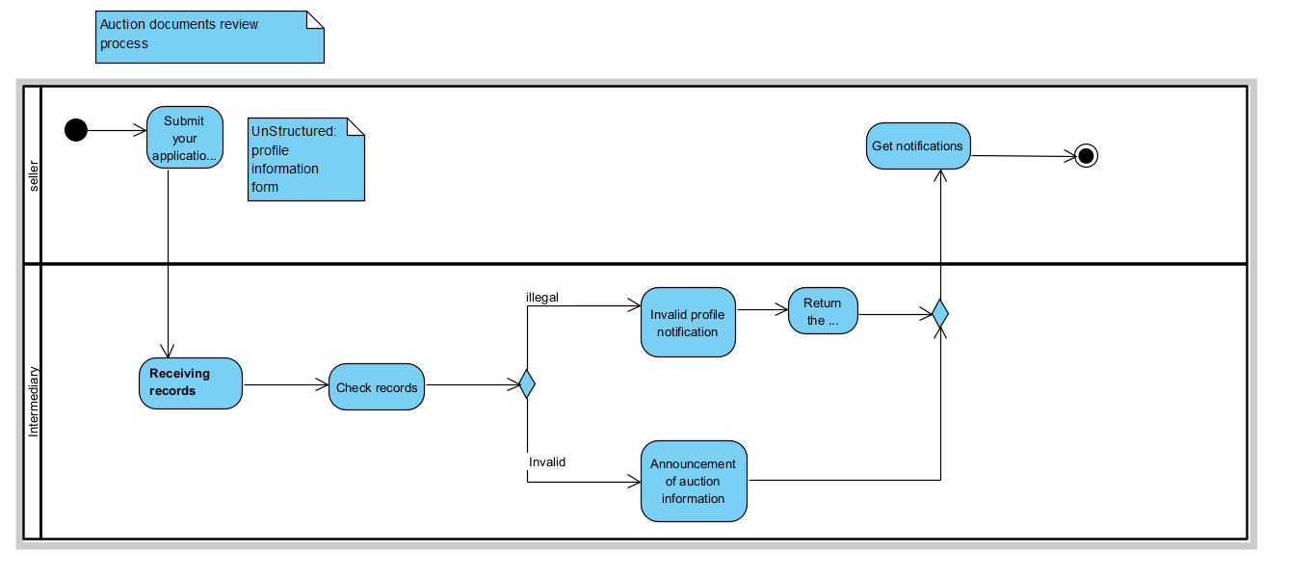

Diagram Auction documents review process

Slide 10
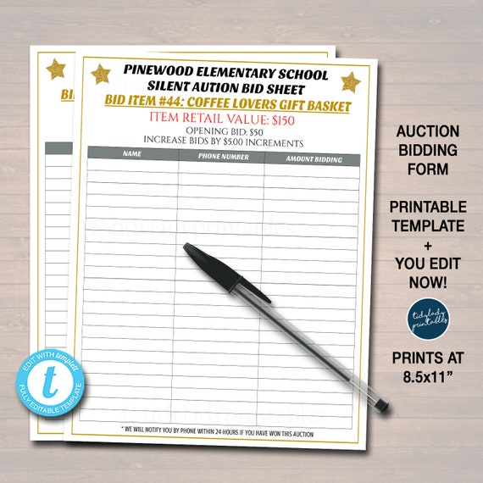
Description
Auction documents review process
In this diagram, we will have the process of reviewing documents to prepare for the auction.First, the user needs to complete the profile according to the given form. Next, submit the application to the auction address.At the auction place, after receiving the application, it will be checked to see if the user has completed enough profile information. If the user has completed the profile, he will be directly notified via email.If the application is not accepted because of missing information or invalid information, the application will be returned and notified of the application's ineligibility.

Slide 11
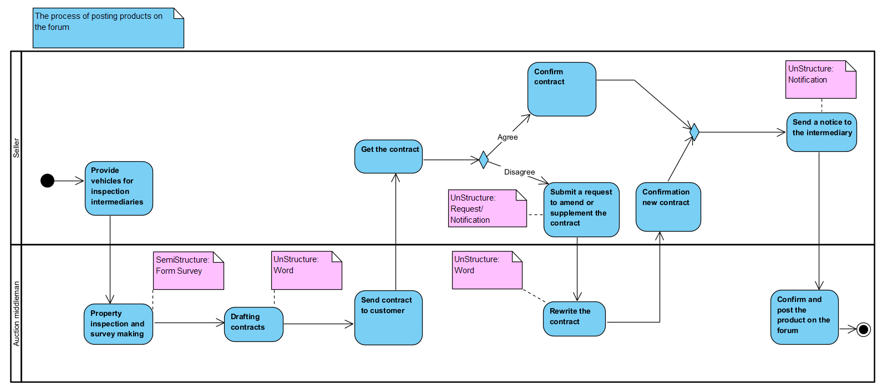
The process of posting products on the forum
Notes:
Description:
Trong sơ đồ lần này chúng ta sẽ có quy trình đưa sản phẩm lên sàn đấu giá.
Người bán sẽ cung cấp xe cho đơn vị đấu giá, đơn vị đấu giá sẽ kiểm tra và đánh giá sản phẩm đồng thời cung cấp một biểu mẫu cho người bán điền thông tin.
Sau khi có đủ thông tin đơn vị đấu giá sẽ soạn thảo hợp đồng, nếu người bán không chấp nhận hợp đồng, hợp đồng sẽ được soạn thảo lại, nếu người bán chấp nhận hợp đồng họ sẽ kí và thông báo cho đơn vị đấu giá.
Khi người bán đã kí hợp đồng đơn vị đấu giá sẽ xác nhận lại và đưa sản phẩm lên diễn đàn đấu giá.

Slide 12
The process of posting products on the forum
Description
In this diagram we will have the process of putting products on the auction floor. The seller will provide the vehicle to the auctioneer, the auctioneer will inspect and evaluate the product and provide a form for the seller to fill out. After having enough information, the auctioneer will draft a contract, if the seller does not accept the contract, the contract will be re-drafted, if the seller accepts the contract, they will sign and notify the auctioneer. price.
When the seller has signed the contract, the auction unit will confirm and put the product on the auction forum.
Notes:
Description:
Trong sơ đồ lần này chúng ta sẽ có quy trình đưa sản phẩm lên sàn đấu giá.
Người bán sẽ cung cấp xe cho đơn vị đấu giá, đơn vị đấu giá sẽ kiểm tra và đánh giá sản phẩm đồng thời cung cấp một biểu mẫu cho người bán điền thông tin.
Sau khi có đủ thông tin đơn vị đấu giá sẽ soạn thảo hợp đồng, nếu người bán không chấp nhận hợp đồng, hợp đồng sẽ được soạn thảo lại, nếu người bán chấp nhận hợp đồng họ sẽ kí và thông báo cho đơn vị đấu giá.
Khi người bán đã kí hợp đồng đơn vị đấu giá sẽ xác nhận lại và đưa sản phẩm lên diễn đàn đấu giá.

Slide 13
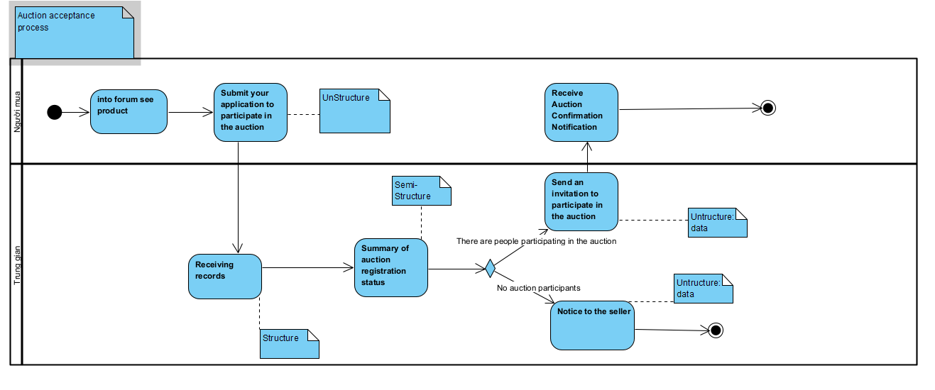
The process of receiving auction participants

Slide 14

The process of receiving auction participants
Description
In the operation of the process diagram for accepting participation in the auction. The buyer first goes to the forum website to view the products, then the buyer registers for auction records, the intermediary will receive the registration information and aggregate all the buyer's records. The intermediary then sends an invitation to the auction and the buyer receives an invitation to the auction.
If no buyer participates in the auction, the intermediary will notify the seller.

Slide 15
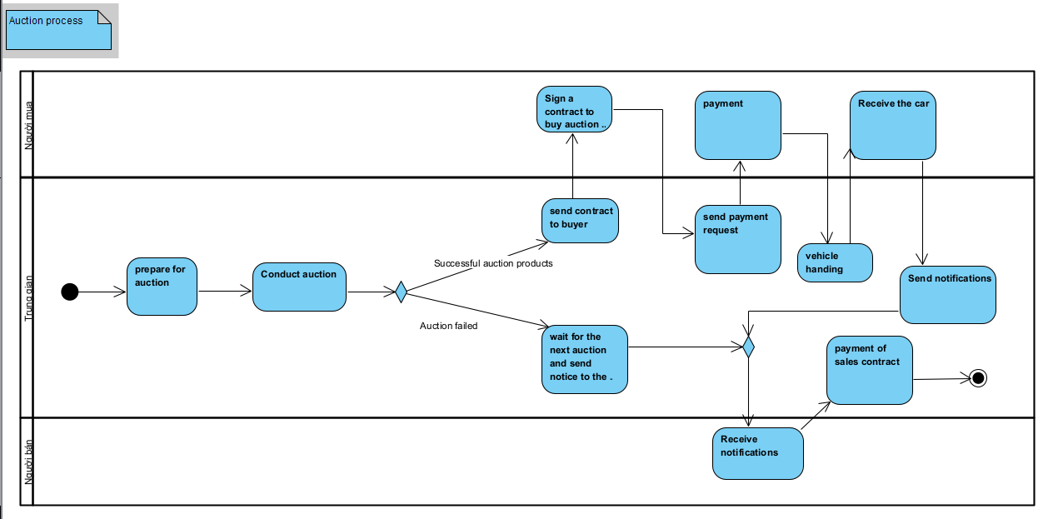
Auction process

Slide 16
Auction process
Description
Regarding the auction process, the company first needs to prepare for the auction (auction room, sound, ...) when the preparation is complete, the auction will be conducted, in the auction process there will be 2 cases It happens that the auction is successful and the auction is not successful. In case of successful auction, the intermediary will send the purchase and sale contract to the buyer and the buyer, after receiving and reading it carefully, will sign a contract with the intermediary. After completing the contract and the intermediary will send a payment request to the buyer and the buyer will make the payment and receive the vehicle delivered by the intermediary. The next step is the intermediary will send a notice about case 1: If the auction is unsuccessful and case 2: successful auction to the customer who is the seller of the auction product. the seller will then receive the notice sent by the intermediary and complete the contract and the auction process ends.

Slide 17
Types of Data
Structured Data
Semi- structured
Unstructured Data

Slide 18
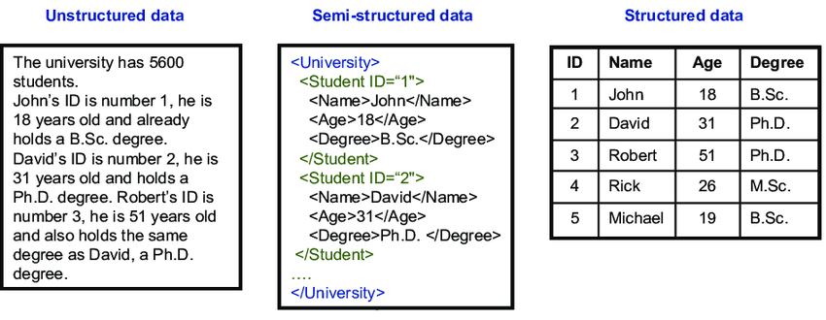
Structured Data
Structured data is the data which conforms to a data model, has a well define structure, follows a consistent order and can be easily accessed and used by a person or a computer program.
Structured data is usually stored in well-defined schemas such as Databases. It is generally tabular with column and rows that clearly define its attributes.

Slide 19
Semi- structured
Semi-structured data is data that does not conform to a data model but has some structure. It lacks a fixed or rigid schema. It is the data that does not reside in a rational database but that have some organizational properties that make it easier to analyze. With some processes, we can store them in the relational database.

Slide 20
Unstructured Data
Unstructured data can be thought of as data that’s not actively managed in a transactional system; for example, data that doesn’t live in a relational database management system (RDBMS). Structured data can be thought of as records (or transactions) in a database environment; for example, rows in a table of a SQL database.

Slide 21
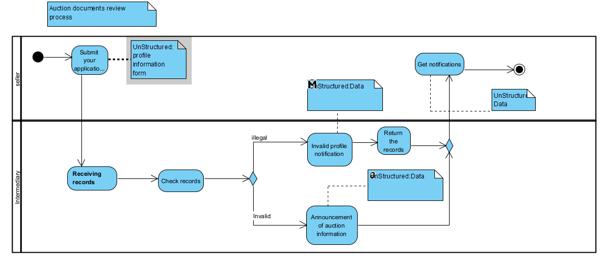
Auction documents review process

Slide 22
Explain
Unstructured data: All the step data in this diagram are of type Unstructured data:
(Send application for approval - receive application - check application)
Users need to complete according to the given information form, then through the receiving place, they will send a request to the processing place. The profile information form is made in writing.
(Notify auction information-Get notified)
After the application is reviewed, the company's customers will be notified via SMS or gmail about the auctioned information.
(Notify invalid application - return application- Receive notification)
For customers who are not approved, the submitted documents will be returned, and will also be notified via SMS and Email.

Slide 23
The process of posting products on the forum
Notes:
SemiStructure data:
Form Survey – đây là một biểu mẫu được soạn thảo trước, nó được dùng để thu thập thông tin về sản phẩm và người bán.
UnStructure data:
Contract – đây là một bản word được soạn thảo sẵn về hợp đồng mua bán đấu giá bao gồm thông tin cơ bản và các điều khoản
Request, Notice – đây là những yêu cầu, thông báo đến từ phía người dùng thông qua gmail, SMS, phone để thông báo, yêu cầu với đơn vị đấu giá.

Slide 24
Explain
SemiStructure data:
Form Survey – this is a pre-written form, it is used to collect information about products and sellers.
UnStructure data:
Contract – this is a pre-drafted word document of an auction sale contract that includes basic information and terms.
Request, Notice – these are requests and notifications coming from users via gmail, SMS, phone to notify and request to the auction unit.
Notes:
SemiStructure data:
Form Survey – đây là một biểu mẫu được soạn thảo trước, nó được dùng để thu thập thông tin về sản phẩm và người bán.
UnStructure data:
Contract – đây là một bản word được soạn thảo sẵn về hợp đồng mua bán đấu giá bao gồm thông tin cơ bản và các điều khoản
Request, Notice – đây là những yêu cầu, thông báo đến từ phía người dùng thông qua gmail, SMS, phone để thông báo, yêu cầu với đơn vị đấu giá.

Slide 25

The process of receiving auction participants

Slide 26
Explain
There are 3 types of data generated during this car auction including structure, semi-structure and unstructure.
Structure
(Receiving auction documents) When a buyer registers for an auction file, the profile information will be added to the database system and managed by an intermediary.
Semi-Structure
(Auction registration records aggregation) All successful auction registration records will be stored in a relational database.
UnStructure
(Send auction registration documents) Buyers fill in auction registration documents and send them in writing.
(Send Invitation to Auction) The intermediary will send an invitation to the buyer in the form of an email, text message, audio encrypted call.
(Notice to Seller) the intermediary will send notice to the seller in the form of an email, text message, audio encrypted call.

Slide 27
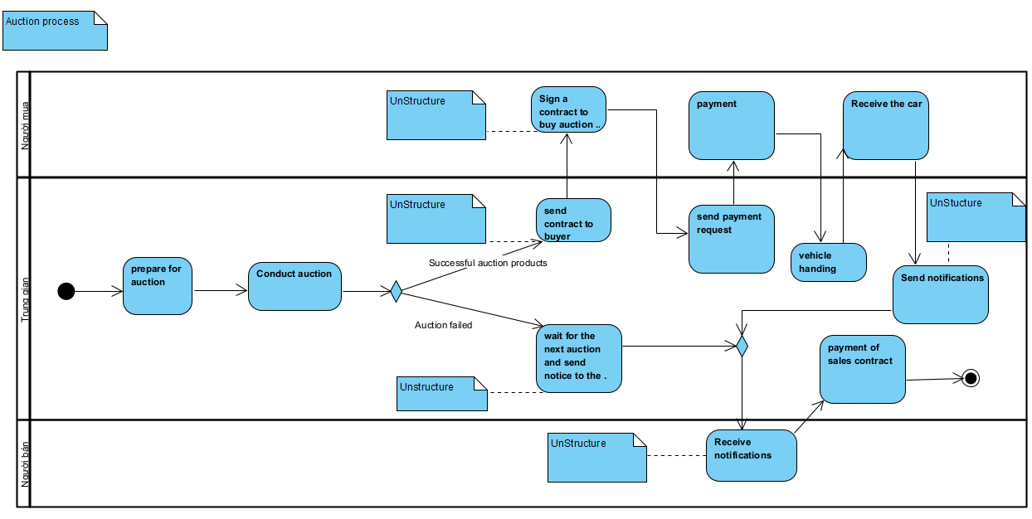
Auction process

Slide 28
Explain
Data Type: UnStructure
The contracts are all word files printed out for both parties to sign, so they will be unstructured
Notices sent to buyers and sellers through intermediaries are unstructure

Slide 29
Information System
Information system is a set of interrelated components that collect or retrieve, process, store, and distribute information to support control and decision-making in a corporation. Information systems can visualize complex subjects, analyze problems, and make new products.
Store and analyze information: Sometimes cloud-based, sophisticated, and comprehensive databases are wont to analyze and store information associated with business functions, transactional data, customers, and employee and customer activities. The results of those analyzes can help decision-makers affect current and future problems.
Assist with making decisions: Information systems can compare internal analyzes with external sources. For instance, compare insider insights with competitors' financial reports or information about the general health of the economy. Decision-makers use these insights to review the adequacy and quality of their strategic decisions.
Assist with business processes: Information systems are wont to develop value-added systems for business functions. Business processes are often simplified. Non-essential activities are often streamlined through the utilization of data systems that adapt to common business tasks, like supply chains, production processes, and employees.

Slide 30
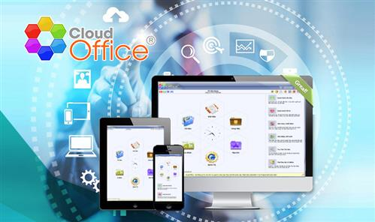
Software used in business process
Cloud Office
Cloud office is a software that supports managing documents, documents and operating work efficiently. This management software will be divided into main modules such as documents, tasks, documents, utilities, administration and personal. In each module, Cloud office software will support you with corresponding management tools. Using Cloud office in management will help the company monitor the auction progress remotely through electronic devices with internet connection. It also becomes easier to exchange and share documents and work information with colleagues or team members.
Notes:
Tiếp theo là một số phần mềm được sử dụng trong business process, đầu tiên thì em sẽ giới thiệu đến phần mềm cloud Office
Cloud office là phần mềm hỗ trợ quản lý văn bản, tài liệu giúp điều hành công việc hiệu quả.
Phần mềm quản lý này sẽ được chia thành các phân hệ chính như văn bản, công việc, tiện ích, quản trị và cá nhân.
Ở mỗi phân hệ, phần mềm Cloud office sẽ có hỗ trợ những công cụ quản lý tương ứng.
Việc sử dụng Cloud office trong quản lý sẽ giúp công ty giám sát từ xa tiến độ đấu giá thông qua các thiết bị điện tử có kết nối internet.
Việc trao đổi, chia sẻ tài liệu và thông tin công việc với đồng nghiệp hoặc thành viên trong nhóm cũng trở nên dễ dàng hơn.

Slide 31
Software Evaluation
Advantages | Disadvantages
Cross-platform operation: Android, iOS, Windows, mac OS | Cloudoffice is suitable for use in managing work in groups, enterprises, and units, so it is a paid software. Although it is a relatively small investment, for many businesses this issue will have to be carefully considered.
Support management of all office operations
Design suitable for many work properties
Diverse features
Save time and costs for businesses
Notes:
Khi sử dụng phần mềm cloud office sẽ có một số lợi ích như:
Có thể sử dụng ở nhiều loại thiết bị như mobile và desktop, Hỗ trợ quản lý mọi hoạt động của văn phòng, tính năng rất là đa dạng, phu hợp với nhiều loại tính chất công việc và tiết kiệm thời gian và tiền bạc cho các tổ chức.
Tuy nhiên phần mềm này có một nhược điểm là đây là một phần mềm trả tiền, cho nên sẽ cần tới ngân sách của công ty và công ty sẽ cần phải tìm hiểu và đánh giá kĩ trước khi mua và sử dụng.

Slide 32
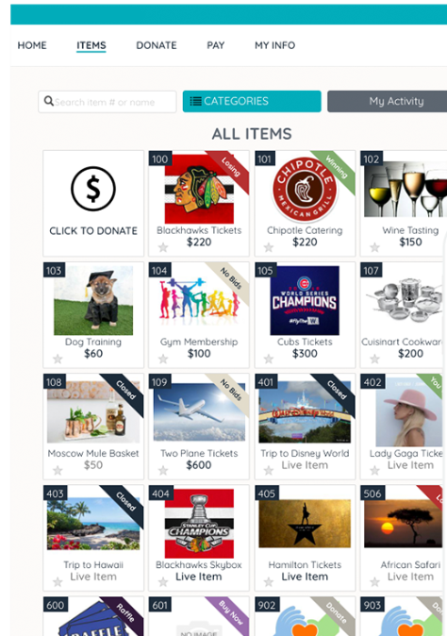
Software used in business process
Give Smart
GiveSmart is an auction and event app specially designed for cloud-based charities. GiveSmart uses advanced algorithms to optimize event processes, increase revenue, and help bidders save money. GiveSmart can be used by many different types of organizations, including K-12 schools, associations, faith-based groups, and nonprofit organizations. It helps manage enrollment, donations, career center, membership, enrollment, fundraising, events, and accounting. Also, to raise awareness of the cause, GiveSmart offers designed pre-and post-event promotional tools. It provides real-time updates along with post-event reports on the most valuable and potential sponsors. Auction features include an auction site, along with online and silent auction capabilities. In addition, customer support is provided to the organization and its participants.

Slide 33
Software Evaluation
Advantages | Disadvantages
Simple platform for the average consumer to understand | The only problem is that we do not have an easy connection between GiveSmart & our accounting system. Our Treasurer has trouble with what she receives from GiveSmart.
Good tech support | One thing that our donors had trouble with was the checking out process.
Good reporting for financial transactions | Unfortunately, in a virtual setting, it seems less risky to run the site and auction yourself on the day of the event.
Communication- GiveSmart has email and text features to communicate with guests

Slide 34
Decision Making Levels
Operational
Tactical
Strategic

Slide 35
Operational decisions
Operational decisions are decisions made to manage the day-to-day business operations. Any company engaged in any kind of business is faced with 100 decisions they have to make in a day. These will be as simple as filling a cooler with water, becoming as stressful as completing a customer order within minutes.
Naturally, operational decisions have to be taken care of by a manager in charge of the operations. However, it is not as easy as it sounds because the number of operations can be mind boggling. On any normal day, McDonald’s sells 75 burgers a second, or 64 million burgers a day across the world. Thing about the number of simple operational decisions that, if not taken properly, can destroy the experiences of customers visiting the McDonald’s stores (Hitesh, 2017).

Slide 36
Operational Decision Example
Example:
move the printer location to the company corridor
training sale skills for new employees

Slide 37
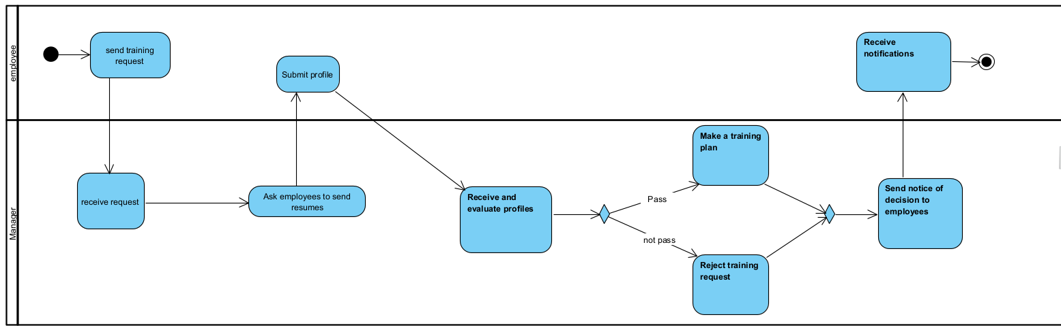
Activity Diagram

Slide 38
BI applied to help make Operational decision
The business intelligence feature used in this example to make this decision is data visualization. It will be used to analyze data over time about the need for additional training for employees, then make assessment, analysis and decision making. determine the training needs of the staff as well as what skills need to be further trained for the employees.
The tool to help with this is tableau, which can more clearly describe many types of charts. You can also use google survey to get data through employee responses. When textual data is displayed in any of these tools, management can easily spot any correlations in the data, allowing the information to be manipulated to provide statistics about the data. opinions of employees to make decisions about which staff to train and on what skills

Slide 39
Tactical decisions
Tactical decisions are decisions and plans that concern the more detailed implementation of the directors’ general strategy, usually with a medium-term impact on a company.
The employees and executives who make tactical decisions for a company typically include being the CEO, COO, CFO, and other top management within a company.
Example:
assign someone to hold a certain position
Manpower planning.
Design the work and work process, including the KPI for each employee for each month.
Plan to improve the use of existing resources.
Planning for modernization of assistive devices and automation.

Slide 40
Tactical Decision Example
Example:
decided to buy office365
choose auction location
Assign Mr.A to be the manager of the Ha Noi facility
offer a promotion event program to reduce 10% discount price for the 2nd auction
30% salary bonus for the employee with the best KPI in the quarter

Slide 41
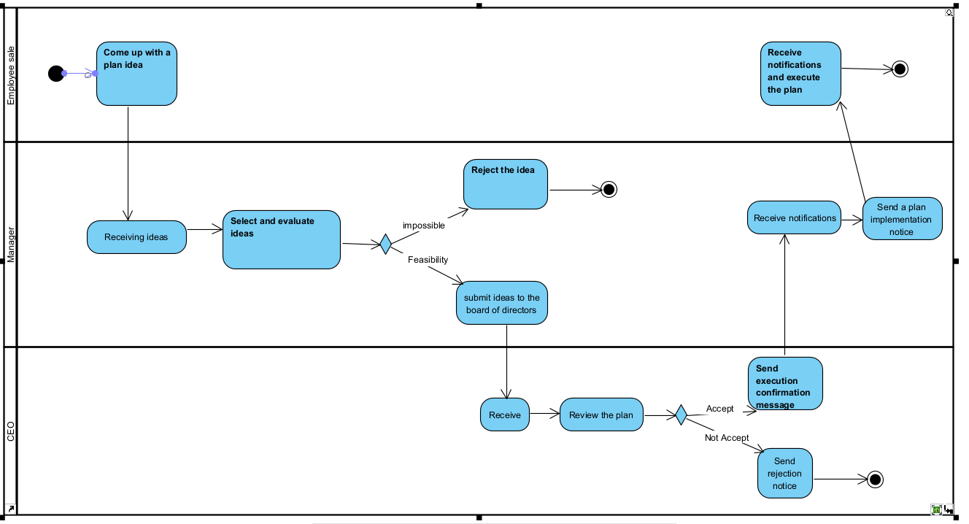
Activity Diagram

Slide 42
BI applied to help make Tactical decision
The business intelligence feature used in this example to make this decision is data visualization. It will be used to analyze data over time about trends and inventory levels and items that need to be sold by percentage, as well as incentives for customers to return for the second time.
The tool that helps with this is tableau, which is more descriptive with multiple charts. Once textual data is displayed in any of these tools, managers can rely on statistics to easily spot any correlations in the data. From the maps, you can make judgments and finally decide how to reduce the price for the most reasonable price.

Slide 43
Strategic decisions
Strategic decisions are decisions and plans that have a long-term or material impact on a company with implications for 5-10 years or more. Strategic decision making includes deciding and developing strategic plans to achieve strategic goals. Those who can make strategic plans are the top leaders of the company.
These decisions or plans are very important to the growth and better functioning of the company. If these decisions are successful, it will affect competitive positions with in the company and help position the company's operational strategy in the future.
Example:
The election of officers and executives
Equity grants or transfers (including compensation packages for officers and executives)
Annual budgets and audits
Shareholder distributions
Sale of substantially all a company’s assets
Dissolution or sale of a company

Slide 44
Strategic decisions Example
Example:
Converting the head office from Ha Noi to Ho Chi Minh City
Expansion of auction scale (receiving real estate auction documents)
Notes:
Chuyển cơ sở từ hà nội vào tp hcm
Mở rộng phạm vi kinh doanh cụ thể là mở rộng xang kinh doanh bất động sản

Slide 45
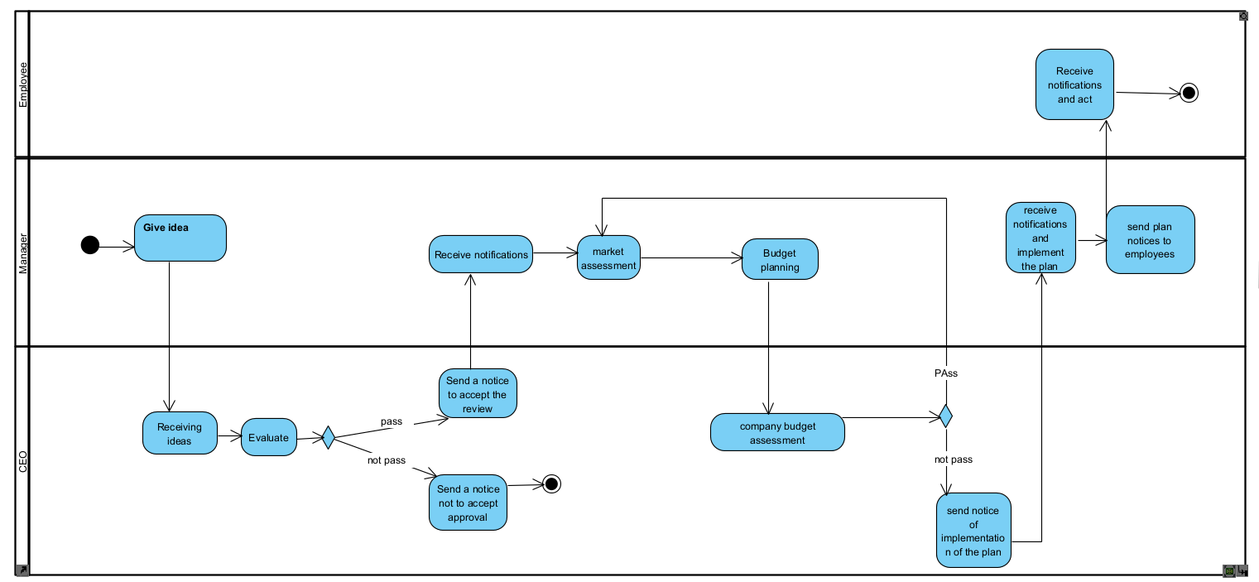
Activity Diagram
Notes:
Và về sơ đồ ví dụ bọn em vẽ về quy trình quyết định mở rộng phạm vi kinh doanh
Đầu tiên quản lý sẽ đưa ra ý tưởng về mở rộng kinh doanh
Sau đó CEO sẽ tiếp nhận ý tưởng và đánh giá qua, nếu ý tưởng không khả thi thì sẽ loại bỏ còn nếu ý tưởng khả thi thì sẽ thông báo cho quản lí
Sau đó quản lý sẽ thực hiện đánh giá thị trường và lập kế hoặc chi phí và gửi lên cho CEO
CEO sẽ xem qua bản báo cáo và đánh giá xem kế hoạch có hợp lý hay không, nếu không hợp lý thì sẽ cho quản lý làm lại còn nếu đã hợp lý thì sẽ gửi thông báo thực hiện cho quản lý và quản lý sẽ gửi thông báo thực hiện cho nhân viên trong công ty.

Slide 46
BI applied to help make Strategic decision
The business intelligence feature used in this example to make this decision is data visualization. It is used to analyze data over time on trends and needs of employees and customers about the needs of the auction profession as well. Then make the decision to have more industries to make it popular and suitable for customers
Software supported in this example might be gg survey and tableau. while gg survey is used to generate questions then ask people to answer those questions so that data can be gathered from their responses. The animation can then use that data to be able to describe more types of charts, the manager can rely on those stats and those charts will make assessment and analysis from there. . can make the decision to add new industries to the company

